Slide 1
2173004 VELINDA NOVELIA CANDRA
TUGAS 2
Goggle Analytics

Slide 2
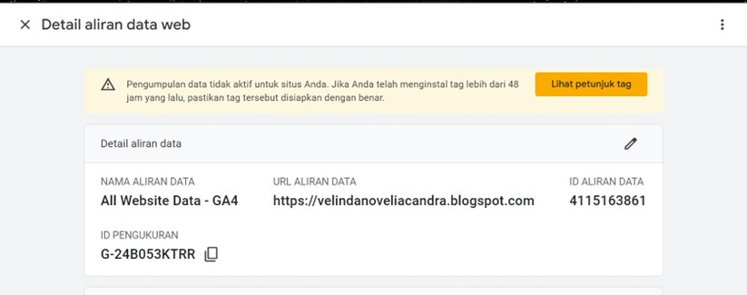

Slide 3
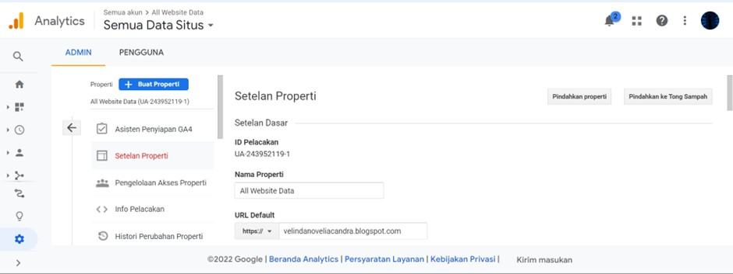

Slide 4
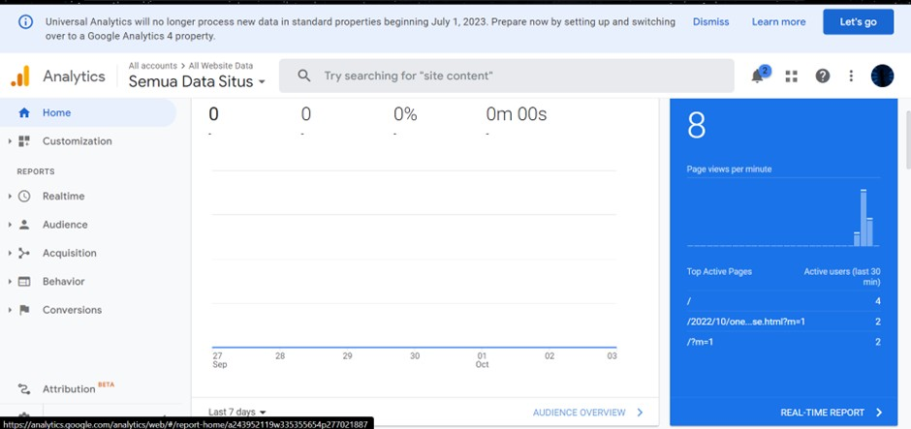

Slide 5
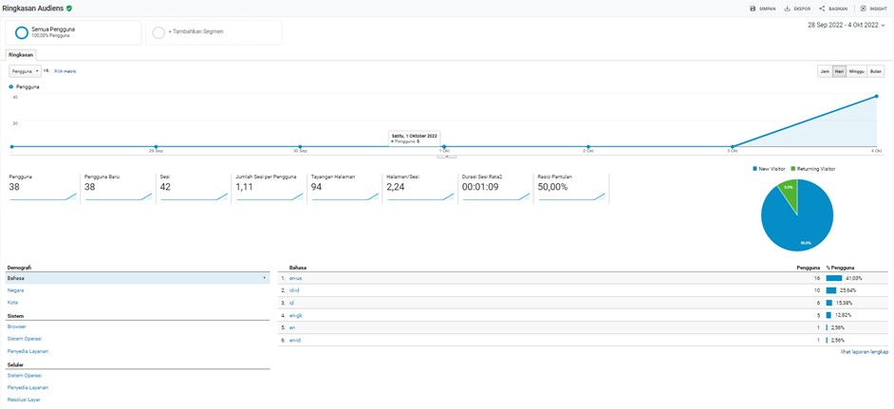
Overview

Slide 6
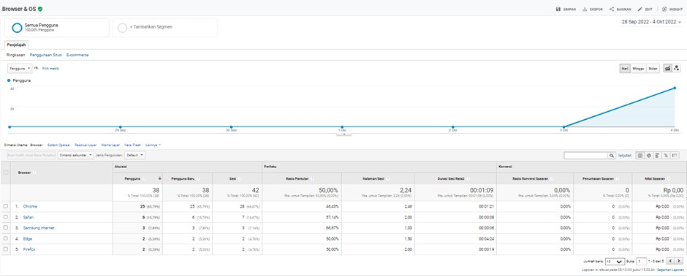
Audiens

Slide 7
Technology

Slide 8
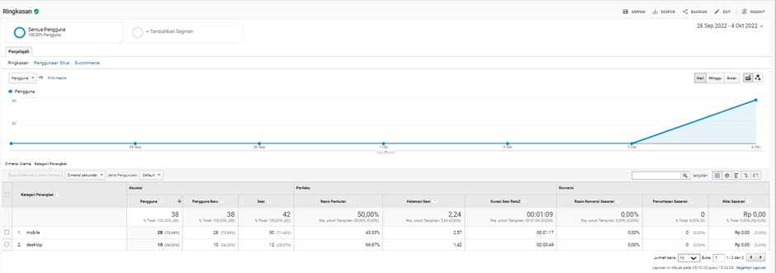
Mobile

Slide 9










THANK YOU

